Slide 1
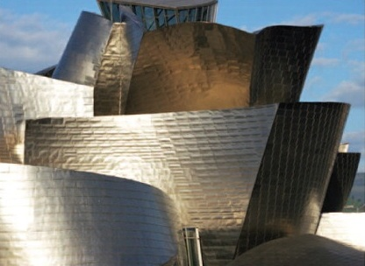
William Stallings Computer Organization and Architecture Compiled and Updated by: Bilal Ahmed
Notes:
Lecture slides prepared for “Computer Organization and Architecture”, 10/e, by William Stallings, Chapter 1 “Introduction”.

Slide 2
Chapter 1
Basic Concepts and Computer Evolution
Notes:
In a class of computers called microcomputers, the relationship between architecture
and organization is very close. Changes in technology not only influence
organization but also result in the introduction of more powerful and more complex
architectures. Generally, there is less of a requirement for generation-
To-generation compatibility for these smaller machines. Thus, there is more interplay between
organizational and architectural design decisions. An intriguing example of this is
the reduced instruction set computer (RISC), which we examine in Chapter 15.
This book examines both computer organization and computer architecture.
The emphasis is perhaps more on the side of organization. However, because a
computer organization must be designed to implement a particular architectural
specification, a thorough treatment of organization requires a detailed examination
of architecture as well.

Slide 3
Computer?
An electronic machine, which:
Takes Input
Processes it
Produces output

Slide 4
Different Types of Computers?
Super Computer
Mainframe Computer
Server Computer
Mini Computer
Micro Computer

Slide 5
Buzz words!
Architecture
Organization
Instruction set
Structure
Function

Slide 6
Computer Organization Vs Architecture
Computer architecture: what the programmer sees – things like instructions, data types, and how memory is accessed. It affects how programs run.
Computer organization: how everything works behind the scenes – the parts inside the computer (like the processor, memory, and how they connect) that make the architecture work.
Architecture: what the system does (from a programmer’s view)
Organization: how the system does it (the internal setup)

Slide 7
Computer Architecture
Computer Architecture refers to features of a computer that a programmer can see and use, such as:
The instruction set (what commands the computer understands)
The number of bits used to represent data (e.g., 32-bit or 64-bit)
Input/Output (I/O) methods
Addressing techniques (how memory is accessed)
It answers the question: "What can the computer do?"
For example: Does it have a multiply instruction?

Slide 8
Computer Organization
Computer Organization is about how the computer's features are built and work.
It includes:
The actual hardware components (like RAM, hard drive, graphics card)
Peripheral devices (how things like the mouse and keyboard are connected)
Control signals (used to manage how parts of the computer work together)
How instructions are carried out in hardware
It answers the question: "How does the computer do it?"
For example: Does it have a hardware unit to multiply, or does it do it by repeated addition?

Slide 9
Real-life Analogy: House Design
Concept | Architecture | Organization
House Design | Blueprint (how many rooms, layout, etc.) | How the builder constructs it (materials, wiring, plumbing layout)
What You See | Floor plan, room types | Wall insulation, pipe layout, electrical routing
Consistency Across | All houses of same model look the same outside | But may use different building materials

Slide 10
Real-life Example: DLD
Aspect | Architecture | Organization
What it does | Performs logic and arithmetic ops | Uses logic gates, adders, MUXes
Defined by | Operation table / truth table / spec | Circuit diagram / internal wiring
Concerned with | Behavior visible to the outside | Physical implementation
Changes often? | No (spec is fixed for a design) | Yes (can optimize or redesign internals)

Slide 11
Real-life Example: Computing
Example | Architecture (What it does) | Organization (How it’s built)
Computing | Intel x86 ISA – instructions like MOV, ADD, etc. | Intel Core i5 vs i7 – different cores, cache size, clock speed
Mobile Chips | ARMv8 ISA – common instruction set in smartphones | Apple M1 vs Snapdragon 8 Gen 2 – different designs, performance, battery life
RISC-V CPU | RISC-V ISA – open standard with defined instructions | One RISC-V CPU may use pipelining, another may be single-cycle
GPU Systems | CUDA or OpenCL Programming Model – defines parallel compute operations | NVIDIA RTX vs AMD Radeon – different core architecture, memory bandwidth, execution units

Slide 12
Architecture | Arrival | Type | Impact
Von Neumann | 1945 | Conceptual | Foundation of modern computing model
Harvard | ~1950s | Conceptual | Crucial for embedded and parallel fetch systems
IBM System/360 | 1964 | CISC | Standardized ISA, large influence on mainframes
Intel x86 | 1978 | CISC | Dominated desktops and later servers
MIPS | 1985 | RISC | Simple and used in education, embedded
ARM | 1985 | RISC (Harvard-like) | Mobile/embedded dominance
SPARC | 1987 | RISC | High-performance servers
PowerPC | 1992 | RISC | Macs, consoles, industrial
x86-64 | 2003 | CISC (64-bit) | Still dominant on desktop/server today
RISC-V | 2010 | RISC (Open-source) | Rapidly growing in education and industry

Slide 13
Tools
Assembly
Verilog
Circuit Verse
Digital JS
Ripes

Slide 14
Concept of computer ‘Family’
A computer family is a category of computers with similar designs and microprocessors that are compatible.
Good examples of different computer families are the IBM or PC family versus the Apple or Mac family of computers
Mostly, all computer families have successive generations, they do share the same architecture. But there are always exceptions

Slide 15
Structure & Function
Computer is a complex system with millions of elementary electronic components
How can one describe them? Key is to recognize the hierarchical nature of the system
Hierarchical system: a set of interrelated subsystems
At each level of hierarchy designer is concerned with two things:
Structure: the way in which components relate to each other
Function: the operation of individual components as part of the structure
The author takes a top down approach to explain the system

Slide 16
CPU – controls the operation of the computer and performs its data processing functions
Main Memory – stores data
I/O – moves data between the computer and its external environment
System Interconnection – some mechanism that provides for communication among CPU, main memory, and I/O
Computer
Major structural components:
Notes:
There are four main structural components:
• Central processing unit (CPU): Controls the operation of the computer and
performs its data processing functions; often simply referred to as processor.
• Main memory: Stores data.
• I/O: Moves data between the computer and its external environment.
• System interconnection: Some mechanism that provides for communication
among CPU, main memory, and I/O. A common example of system interconnection
is by means of a system bus, consisting of a number of conducting
wires to which all the other components attach.

Slide 17
Control Unit
Controls the operation of the CPU and hence the computer
Arithmetic and Logic Unit (ALU)
Performs the computer’s data processing function
Registers
Provide storage internal to the CPU
CPU Interconnection
Some mechanism that provides for communication among the control unit, ALU, and registers
CPU
Major structural components:
Notes:
There may be one or more of each of the aforementioned components.
Traditionally, there has been just a single processor. In recent years, there has been
increasing use of multiple processors in a single computer. Some design issues relating
to multiple processors crop up and are discussed as the text proceeds; Part Five
focuses on such computers.
Each of these components will be examined in some detail in Part Two.
However, for our purposes, the most interesting and in some ways the most complex
component is the CPU. Its major structural components are as follows:
• Control unit: Controls the operation of the CPU and hence the computer.
• Arithmetic and logic unit (ALU): Performs the computer’s data processing
functions.
• Registers: Provides storage internal to the CPU.
• CPU interconnection: Some mechanism that provides for communication
among the control unit, ALU, and registers.
Part Three covers these components, where we will see that complexity is added by
the use of parallel and pipelined organizational techniques. Finally, there are several
approaches to the implementation of the control unit; one common approach is
a microprogrammed implementation. In essence, a microprogrammed control unit
operates by executing microinstructions that define the functionality of the control
unit. With this approach, the structure of the control unit can be depicted, as in
Figure 1.1. This structure is examined in Part Four.

Slide 18
Function
There are four basic functions that a computer can perform:
Data processing
Data may take a wide variety of forms and the range of processing requirements is broad
Data storage
Short-term
Long-term
Data movement
Input-output (I/O) - when data are received from or delivered to a device (peripheral) that is directly connected to the computer
Data communications – when data are moved over longer distances, to or from a remote device
Control
A control unit manages the computer’s resources and orchestrates the performance of its functional parts in response to instructions
Notes:
Both the structure and functioning of a computer are, in essence, simple. Figure 1.1
depicts the basic functions that a computer can perform. In general terms, there are
only four:
Data Processing. The data may take a wide
variety of forms, and the range of processing requirements is broad. However, we
shall see that there are only a few fundamental methods or types of data processing.
Data Storage. Even if the computer is processing
data on the fly (i.e., data come in and get processed, and the results go out
immediately), the computer must temporarily store at least those pieces of data
that are being worked on at any given moment. Thus, there is at least a short-term
data storage function. Equally important, the computer performs a long-term data
storage function. Files of data are stored on the computer for subsequent retrieval
and update.
Data Movement. The computer’s operating environment consists of devices that serve as
either sources or destinations of data. When data are received from or delivered to
a device that is directly connected to the computer, the process is known as input–
output (I/O), and the device is referred to as a peripheral. When data are moved
over longer distances, to or from a remote device, the process is known as data
communications.
Control. Within the computer, a control unit manages the computer’s resources and orchestrates the
performance of its functional parts in response to those instructions.

Slide 19
Structure
Notes:
We now look in a general way at the internal structure of a computer. We begin with
a traditional computer with a single processor that employs a microprogrammed
control unit, then examine a typical multicore structure.
Figure 1.1 provides a hierarchical view
of the internal structure of a traditional single-processor computer.

Slide 20
The Control Unit
Sequence Logic Circuit: This type of circuit's output depends not only on the current input but also on past inputs.
Control Memory: It stores the microprogram in a microprogrammed control unit.
Writable Control Memory: This is control memory that can be changed, allowing the microprogram and instruction set to be modified.
Control Unit: It uses registers and decoders to convert instructions into control signals that guide other parts of the computer, like memory, the arithmetic unit, and input/output devices.

Slide 21
Example: Instruction ADD R1, R2
1. Sequential Logic Circuit
This remembers which step we are on while executing the instruction.
Example:
Step 1: Fetch the instruction
Step 2: Decode it
Step 3: Execute it
The sequential logic keeps track of these steps (like a state machine).

Slide 22
Example: Instruction ADD R1, R2
2. Control Memory
Inside control memory, there is a microprogram (a set of small steps) for ADD.
Example micro-steps stored:
Get operand from R1
Get operand from R2
Tell ALU to add them
Store result back into R1

Slide 23
Example: Instruction ADD R1, R2
3. Writable Control Memory
If the CPU designer wants to change how ADD works (for example, to support floating-point addition instead of integer), they can update the writable control memory.
This makes the CPU more flexible compared to hardwired logic.

Slide 24
Example: Instruction ADD R1, R2
4. Control Unit
The control unit is the traffic manager:
It reads the ADD R1, R2 instruction.
It decodes it into signals (like “read R1,” “read R2,” “tell ALU to add,” “write back to R1”).
These signals are sent to the registers and ALU at the right time.

Slide 25
Summary
Sequential circuit → Keeps track of which micro-step we’re in.
Control memory → Stores the recipe (set of micro instructions) for how to perform ADD.
Writable control memory → Lets us update/change that recipe.
Control unit → Sends actual signals to ALU, memory, registers.

Slide 26
Control Unit Registers and Decoders (2 to 4 bit Decoder)

Slide 27
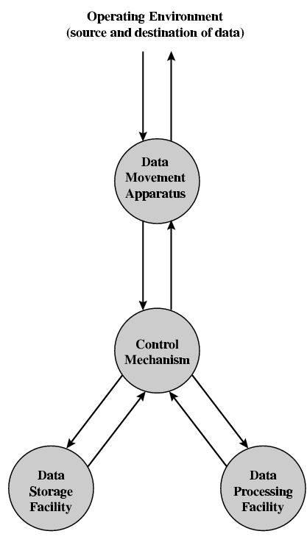
Functional View

Slide 28
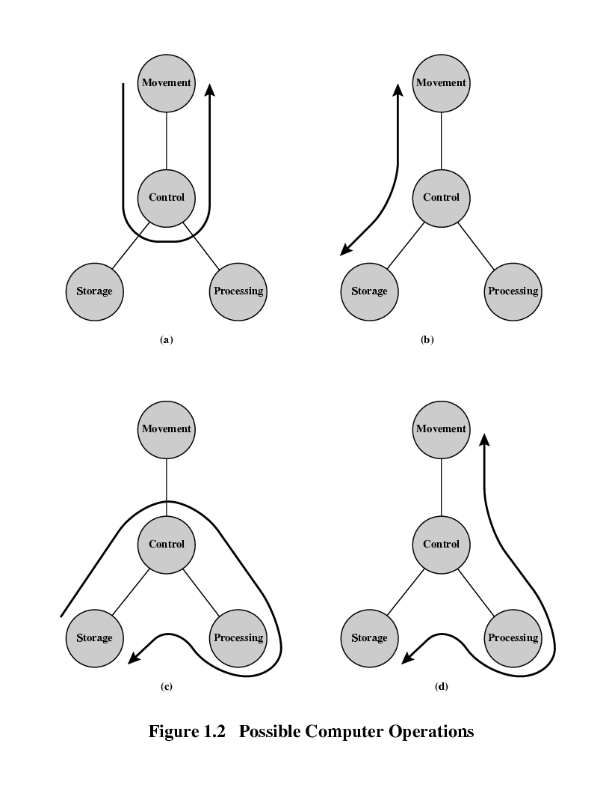
Data movement

Slide 29
Storage

Slide 30
Processing (From or To Storage)

Slide 31
Processing (From or To I/O)

Slide 32

Why should we study CA?
Understand How Computers Work: Learn how instructions are executed, how memory is accessed, and how hardware/software interact.
Optimize Software: Writing efficient code requires knowing how CPUs, caches, and pipelines behave.
Design Better Hardware: Knowledge of architecture is essential if you want to design processors, embedded systems, or robotics controllers.
Bridge Between Hardware & Software: Architecture connects programming (software) with circuit design (hardware).
Evaluate & Choose Systems: Helps compare CPUs (e.g., Intel vs ARM) for speed, power, and cost depending on the application.
Foundation for Advanced Fields: Critical for Operating Systems, Compilers, AI accelerators, Robotics, High-performance Computing.

Slide 33
First Generation (1940s–1950s) – Vacuum Tubes
Hardware: Vacuum tubes for circuits, punch cards for input/output.
Memory: Magnetic drums.
Programming: Machine language (0s/1s), very hard to program.
Example machines: ENIAC (1945), UNIVAC (1951).
Architecture concept: Von Neumann architecture (stored-program computers) introduced.

Slide 34
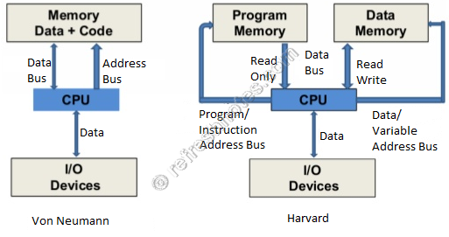
Von Neumann vs Harvard

Slide 35
Von Neumann vs Harvard
Feature | Von Neumann Architecture | Harvard Architecture
Memory | Single memory for data & instructions | Separate memory for data & instructions
Bus System | One bus (shared) | Two buses (separate)
Instruction & Data | Fetched one at a time (sequential) | Can fetch instruction & data simultaneously
Speed | Slower due to bottleneck | Faster (no bottleneck)
Complexity | Simpler, cheaper | More complex, costly
Usage | General-purpose computers (PCs, servers) | Microcontrollers, DSPs, embedded systems

Slide 36
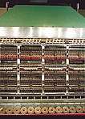
IAS Computer
The IAS machine was the first electronic computer to be built at the Institute for Advanced Study (IAS) in Princeton, New Jersey. It is sometimes called the von Neumann machine, since the paper describing its design was edited by John von Neumann

Slide 37
IAS Computer
The IAS machine was a binary computer with a 40-bit word, storing two 20-bit instructions in each word.
The memory was 1,024 words (5.1 kilobytes). Negative numbers were represented in two's complement format.
It was an asynchronous machine, meaning that there was no central clock regulating the timing of the instructions. One instruction started executing when the previous one finished.
Von Neumann showed how the combination of instructions and data in one memory could be used to implement loops, by modifying branch instructions when a loop was completed, for example.
The requirement that instructions, data and input/output be accessed via the same bus later came to be known as the Von Neumann bottleneck.

Slide 38
Early Computers
Feature / Machine | Harvard Mark I (1944) | ENIAC (1945) | EDVAC (1949) | UNIVAC I (1951)
Generation | 1st (Electromechanical) | 1st (Electronic, vacuum tubes) | 1st (Electronic) | 1st (Commercial Electronic)
Architecture | Harvard (separate program & data, punched tape) | Hard-wired, no stored program | Von Neumann (stored-program) | Von Neumann (stored-program)
Programming | Punched tape input (fixed) | Manual rewiring of plugboards | Instructions stored in memory | Instructions stored in memory
Flexibility | Very limited | Faster but hard to reprogram | Flexible (load different programs in memory) | Flexible & commercial use
Tech | Electromechanical relays | ~18,000 vacuum tubes | Vacuum tubes | Vacuum tubes
Significance | Transition from calculators → early computers | First general-purpose electronic computer | First to implement stored-program concept | First commercially available stored-program computer (software era begins)

Slide 39

Harvard Architecture
Harvard Mark I (1944) – electromechanical computer, designed at Harvard University by Howard Aiken.
Programs were stored on punched tape (instructions).
Data was stored in electromechanical counters (separate from instructions).

Slide 40
Von Neumann Architecture (Implemented Early)
1949
EDVAC (1949) → first true Von Neumann machine.
1951
UNIVAC I (1951) → first commercial computer.
1952
IBM 701 (1952) → first IBM scientific computer.

Slide 41
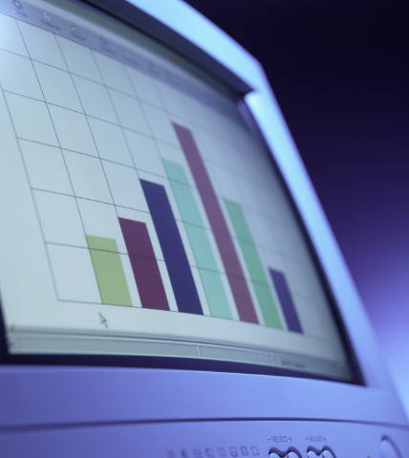
IBM
Was the major manufacturer of punched-card processing equipment
Delivered its first electronic stored-program computer (701) in 1953
Intended primarily for scientific applications
Introduced 702 product in 1955
Hardware features made it suitable to business applications
Series of 700/7000 computers established IBM as the overwhelmingly dominant computer manufacturer
Notes:
IBM, then the major manufacturer of punched-card processing equipment,
delivered its first electronic stored-program computer, the 701, in 1953. The 701 was
intended primarily for scientific applications [BASH81]. In 1955, IBM introduced
the companion 702 product, which had a number of hardware features that suited it
to business applications. These were the first of a long series of 700/7000 computers
that established IBM as the overwhelmingly dominant computer manufacturer.

Slide 42
Second Generation (1950s–1960s) – Transistors
Hardware: Transistors replaced vacuum tubes → smaller, faster, more reliable.
Memory: Magnetic cores.
Programming: Assembly language introduced, plus early high-level languages (FORTRAN, COBOL).
Example machines: IBM 7090, PDP-1.
Architecture: More emphasis on instruction sets and control units.

Slide 43
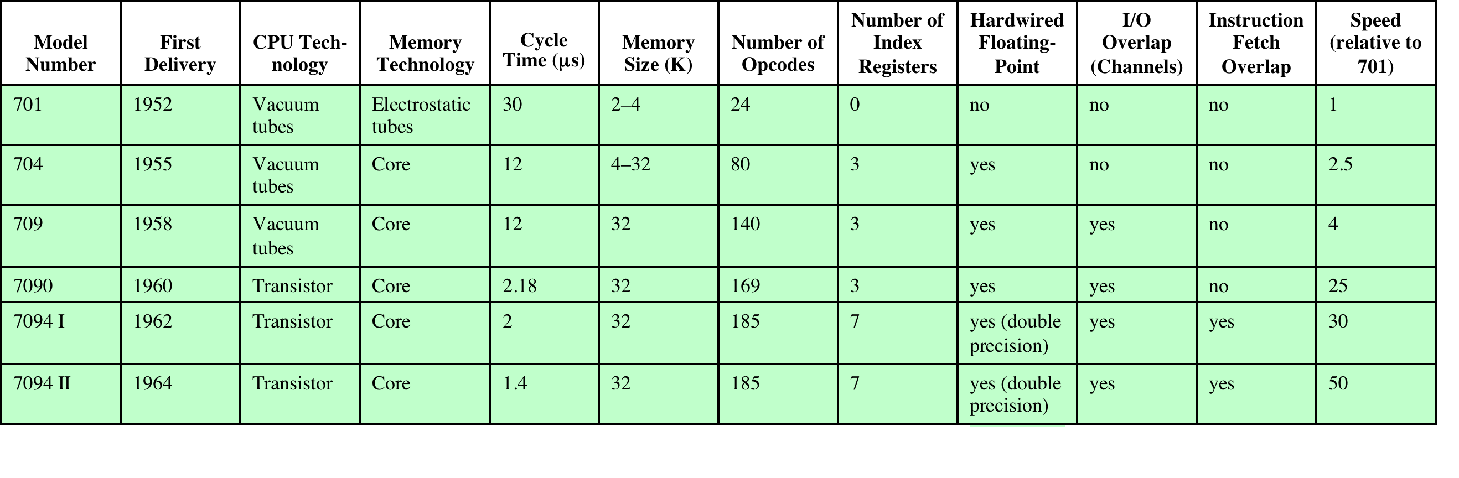
Members of the IBM 700/7000 Series
Notes:
From the introduction of the 700 series in 1952 to the introduction
of the last member of the 7000 series in 1964, this IBM product line underwent an
evolution that is typical of computer products. Successive members of the product
line show increased performance, increased capacity, and/or lower cost.
Table 2.3 illustrates this trend. The size of main memory, in multiples of 2¹⁰
36-bit words, grew from 2K (1K = 2¹⁰) to 32K words, while the time to access one
word of memory, the memory cycle time, fell from 30 μs to 1.4 μs. The number of
opcodes grew from a modest 24 to 185.
The final column indicates the relative execution speed of the central processing
unit (CPU). Speed improvements are achieved by improved electronics (e.g., a
transistor implementation is faster than a vacuum tube implementation) and more
complex circuitry. For example, the IBM 7094 includes an Instruction Backup
Register, used to buffer the next instruction. The control unit fetches two adjacent
words from memory for an instruction fetch. Except for the occurrence of a branching
instruction, which is relatively infrequent (perhaps 10 to 15%), this means that
the control unit has to access memory for an instruction on only half the instruction
cycles. This prefetching significantly reduces the average instruction cycle time.
The remainder of the columns of Table 2.3 will become clear as the text
proceeds.

Slide 44
Important Terms
Cycle Time (µs): The time, in microseconds, it takes to complete one basic machine operation.
Memory Size (K): The total capacity of the main memory, in thousands of units.
Number of Opcodes: The count of unique instructions the CPU can execute.
Number of Index Registers: The number of specialized registers used for address modification.
Hardwired Floating-Point: A dedicated hardware unit for performing floating-point arithmetic.
I/O Overlap (Channels): The ability to perform input/output operations simultaneously with CPU processing.
Instruction Fetch Overlap: The capability to retrieve the next instruction while the current one is still executing.
Speed (relative to 701): A measure of the model's processing speed compared to the original 701 model.

Slide 45
IBM-7094
Includes an Instruction Backup Register, used to buffer the next instruction.
The control unit fetches two adjacent words from memory for an instruction fetch.
A data channel is an independent I/O module with its own processor and instruction set.
CPU does not execute detailed I/O instructions.
The CPU initiates an I/O transfer by sending a control signal to the data channel, instructing it to execute a sequence of instructions in memory.
The multiplexor schedules access to the memory from the CPU and data channels, allowing these devices to act independently.

Slide 46
Notes:
It will be useful to examine an important member of the second generation: the
IBM 7094 [BELL71]. From the introduction of the 700 series in 1952 to the introduction
of the last member of the 7000 series in 1964, this IBM product line underwent
an evolution that is typical of computer products. Successive members of the product
line showed increased performance, increased capacity, and/or lower cost.
Also, over the lifetime of this series of computers, the relative speed of the
CPU increased by a factor of 50. Speed improvements are achieved by improved
electronics (e.g., a transistor implementation is faster than a vacuum tube implementation)
and more complex circuitry. For example, the IBM 7094 includes an
Instruction Backup Register, used to buffer the next instruction. The control unit
fetches two adjacent words from memory for an instruction fetch. Except for the
occurrence of a branching instruction, which is relatively infrequent (perhaps 10 to
15%), this means that the control unit has to access memory for an instruction on
only half the instruction cycles. This prefetching significantly reduces the average
instruction cycle time.
Figure 1.9 shows a large (many peripherals) configuration for an IBM 7094,
which is representative of second-generation computers. Several differences from
the IAS computer are worth noting. The most important of these is the use of data
channels . A data channel is an independent I/O module with its own processor and
instruction set. In a computer system with such devices, the CPU does not execute
detailed I/O instructions. Such instructions are stored in a main memory to be
executed by a special-purpose processor in the data channel itself. The CPU initiates
an I/O transfer by sending a control signal to the data channel, instructing it to
execute a sequence of instructions in memory. The data channel performs its task
independently of the CPU and signals the CPU when the operation is complete.
This arrangement relieves the CPU of a considerable processing burden.
Another new feature is the multiplexor , which is the central termination
point for data channels, the CPU, and memory. The multiplexor schedules access
to the memory from the CPU and data channels, allowing these devices to act
independently.

Slide 47
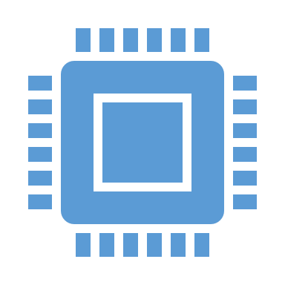
Third Generation (1960s–1970s) – Integrated Circuits (ICs)
Hardware: Integrated Circuits (ICs) replaced individual transistors.
OS: Multiprogramming & time-sharing introduced.
Programming: More high-level languages (C, BASIC).
Example machines: IBM System/360, PDP-8, DEC VAX.
Architecture: CISC (Complex Instruction Set Computers) become standard.

Slide 48

Integrated Circuits
Data storage – provided by memory cells
Data processing – provided by gates
Data movement – the paths among components are used to move data from memory to memory and from memory through gates to memory
Control – the paths among components can carry control signals
The two most important members of the third generation were the IBM System/360 and the DEC PDP-8
Notes:
We can relate this to our four
basic functions as follows:
• Data storage: Provided by memory cells.
• Data processing: Provided by gates.
• Data movement: The paths among components are used to move data from
memory to memory and from memory through gates to memory.
• Control: The paths among components can carry control signals. For example,
a gate will have one or two data inputs plus a control signal input that activates
the gate. When the control signal is ON, the gate performs its function on the
data inputs and produces a data output. Similarly, the memory cell will store
the bit that is on its input lead when the WRITE control signal is ON and will
place the bit that is in the cell on its output lead when the READ control signal
is ON.
Thus, a computer consists of gates, memory cells, and interconnections among these
elements. The gates and memory cells are, in turn, constructed of simple digital
electronic components.
The integrated circuit exploits the fact that such components as transistors,
resistors, and conductors can be fabricated from a semiconductor such as silicon.
It is merely an extension of the solid-state art to fabricate an entire circuit in a tiny
piece of silicon rather than assemble discrete components made from separate
pieces of silicon into the same circuit. Many transistors can be produced at the same
time on a single wafer of silicon. Equally important, these transistors can be connected
with a process of metallization to form circuits.

Slide 49
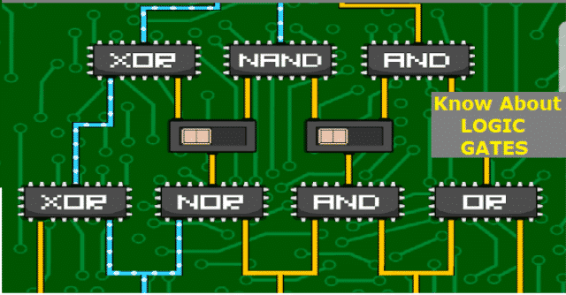
Integrated Circuits
A computer consists of gates, memory cells, and interconnections among these elements
The gates and memory cells are constructed of simple digital electronic components

Slide 50
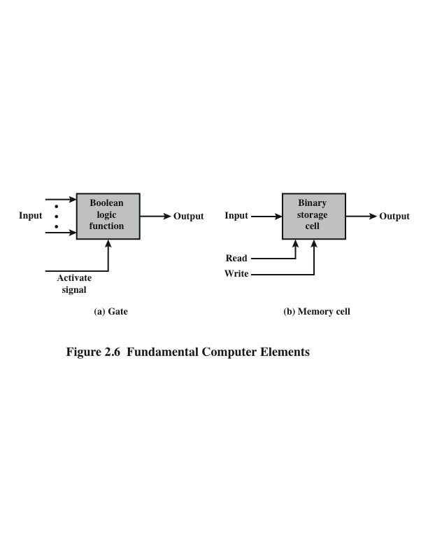
Microelectronics
Notes:
Microelectronics means, literally, “small electronics.” Since
the beginnings of digital electronics and the computer industry, there has been a
persistent and consistent trend toward the reduction in size of digital electronic
circuits. Before examining the implications and benefits of this trend, we need to
say something about the nature of digital electronics. A more detailed discussion is
found in Chapter 11.
The basic elements of a digital computer, as we know, must perform storage,
movement, processing, and control functions. Only two fundamental types of components
are required (Figure 2.6): gates and memory cells. A gate is a device that
implements a simple Boolean or logical function, such as IF A AND B ARE TRUE
THEN C IS TRUE (AND gate). Such devices are called gates because they control
data flow in much the same way that canal gates control the flow of water. The
memory cell is a device that can store one bit of data; that is, the device can be in
one of two stable states at any time. By interconnecting large numbers of these
fundamental devices, we can construct a computer.

Slide 51
Notes:
Figure 1.11 depicts the key concepts in an integrated circuit. A thin wafer of
silicon is divided into a matrix of small areas, each a few millimeters square. The
identical circuit pattern is fabricated in each area, and the wafer is broken up into
chips. Each chip consists of many gates and/or memory cells plus a number of input
and output attachment points. This chip is then packaged in housing that protects
it and provides pins for attachment to devices beyond the chip. A number of these
packages can then be interconnected on a printed circuit board to produce larger
and more complex circuits.

Slide 52
Notes:
Initially, only a few gates or memory cells could be reliably manufactured
and packaged together. These early integrated circuits are referred to as small scale
Integration (SSI). As time went on, it became possible to pack more and more
Components on the same chip. This growth in density is illustrated in Figure 1.12; it is
one of the most remarkable technological trends ever recorded.
This figure reflects the
famous Moore’s law, which was propounded by Gordon Moore, cofounder of Intel,
in 1965 [MOOR65]. Moore observed that the number of transistors that could be
put on a single chip was doubling every year and correctly predicted that this pace
would continue into the near future. To the surprise of many, including Moore, the
pace continued year after year and decade after decade. The pace slowed to a doubling
every 18 months in the 1970s but has sustained that rate ever since.

Slide 53
Moore’s Law
Proposed by: Gordon Moore (Intel, 1965)
Statement: Transistor count on a chip doubles every ~18–24 months, while cost per transistor halves.
Faster & cheaper computers
Smaller devices (miniaturization)
Growth of PCs, smartphones, AI
1971: Intel 4004 → 2,300 transistors
2023: Apple M2 → ~20 billion transistors

Slide 54
IBM System/360
Announced in 1964
Product line was incompatible with older IBM machines
Was the success of the decade and cemented IBM as the overwhelmingly dominant computer vendor
The architecture remains to this day the architecture of IBM’s mainframe computers
Was the industry’s first planned family of computers
Models were compatible in the sense that a program written for one model should be capable of being executed by another model in the series
Notes:
By 1964, IBM had a firm grip on the computer market with
its 7000 series of machines. In that year, IBM announced the System/360, a new
family of computer products. Although the announcement itself was no surprise, it
contained some unpleasant news for current IBM customers: the 360 product line
was incompatible with older IBM machines. Thus, the transition to the 360 would be
difficult for the current customer base. This was a bold step by IBM, but one IBM felt
was necessary to break out of some of the constraints of the 7000 architecture and
to produce a system capable of evolving with the new integrated circuit technology
[PADE81, GIFF87]. The strategy paid off both financially and technically. The 360
was the success of the decade and cemented IBM as the overwhelmingly dominant
computer vendor, with a market share above 70%. And, with some modifications
and extensions, the architecture of the 360 remains to this day the architecture
of IBM’s mainframe computers. Examples using this architecture can be found
throughout this text.
The System/360 was the industry’s first planned family of computers. The
family covered a wide range of performance and cost. The models were compatible in the sense that
a program written for one model should be capable of being executed by another
model in the series, with only a difference in the time it takes to execute.

Slide 55
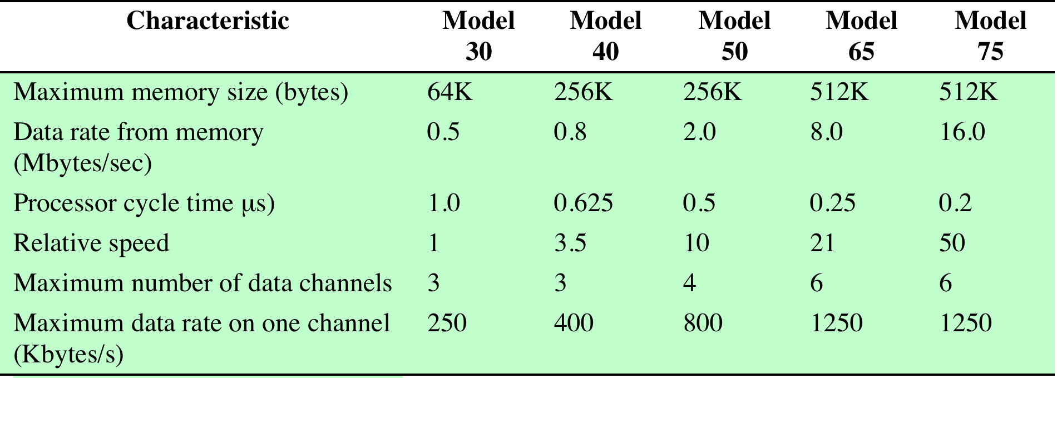
Characteristics of the System/360 Family

Slide 56
DEC-PDP-8
Same year(IBM system/360) –PDP-8 from Digital Equipment Corporation
Small enough to be placed on top of bench
No air-conditioned room required
Cheap enough (Not exact functionality like mainframe)
Introduced the concept of Omnibus( Bus structure for microcomputers)

Slide 57
DEC-PDP-8
Consist of 96 separate signal paths
Used to carry data, address and control signals
All system components share a common set of signal paths
Their use controlled by CPU
Flexible architecture→ modules to be plugged into the bus

Slide 58
Notes:
In the same year that IBM shipped its first System/360, another
momentous first shipment occurred: PDP-8
from Digital Equipment Corporation(DEC). At a time when the average
computer required an air-conditioned room, the PDP-8
(dubbed a minicomputer by the industry, after the miniskirt of the day)
was small enough that it could be placed on top of a lab bench or be built into
other equipment. It could not do everything the mainframe could, but at $16,000, it
was cheap enough for each lab technician to have one. In contrast, the System/360
series of mainframe computers introduced just a few months before cost hundreds
of thousands of dollars.
The low cost and small size of the PDP-8
enabled another manufacturer to purchase a PDP-8
and integrate it into a total system for resale. These other manufacturers
came to be known as original equipment manufacturers (OEMs) , and the
OEM market became and remains a major segment of the computer marketplace.
In contrast to the central-switched architecture (Figure 1.9) used by IBM on its
700/7000 and 360 systems, later models of the PDP-8
used a structure that became virtually
universal for microcomputers: the bus structure. This is illustrated in Figure 1.13.
The PDP-8 bus, called the Omnibus, consists of 96 separate signal paths, used to carry
control, address, and data signals. Because all system components share a common
set of signal paths, their use can be controlled by the CPU. This architecture is highly
flexible, allowing modules to be plugged into the bus to create various configurations.
It is only in recent years that the bus structure has given way to a structure known as
Point-to-point interconnect, described in Chapter 3.

Slide 59
Computer Generations
Notes:
It has become widely accepted to classify computers into generations based on the fundamental
hardware technology employed (Table 1.2). Each new generation is characterized
by greater processing performance, larger memory capacity, and smaller
size than the previous one.

Slide 60
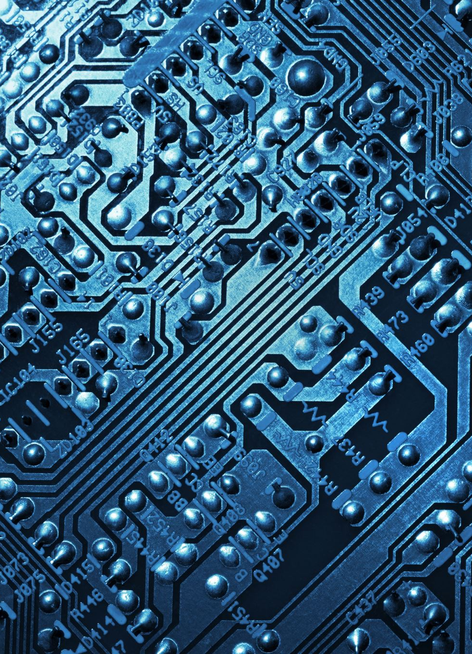
Fourth Generation (1970s–1990s) – Microprocessors
Hardware: Microprocessors (entire CPU on a single chip).
PCs introduced: Apple II, IBM PC (1981).
Memory: Semiconductor memory (RAM, ROM).
Examples: Intel 8086 (1978) → basis of today’s x86.
Architecture:
CISC (x86) dominant in PCs.
RISC (Reduced Instruction Set Computer) ideas emerge in 1980s (MIPS, SPARC, ARM).

Slide 61
Microprocessors
The density of elements on processor chips continued to rise
More and more elements were placed on each chip so that fewer and fewer chips were needed to construct a single computer processor
1971 Intel developed 4004
First chip to contain all of the components of a CPU on a single chip
Birth of microprocessor
1972 Intel developed 8008
First 8-bit microprocessor
1974 Intel developed 8080
First general purpose microprocessor
Faster, has a richer instruction set, has a large addressing capability
Notes:
Just as the density of elements on memory chips has continued
to rise, so has the density of elements on processor chips. As time went on, more
and more elements were placed on each chip, so that fewer and fewer chips were
needed to construct a single computer processor.
A breakthrough was achieved in 1971, when Intel developed its 4004. The
4004 was the first chip to contain all of the components of a CPU on a single chip:
The microprocessor was born.
The 4004 can add two 4-bit numbers and can multiply only by repeated addition.
By today’s standards, the 4004 is hopelessly primitive, but it marked the beginning of
a continuing evolution of microprocessor capability and power.
This evolution can be seen most easily in the number of bits that the processor
deals with at a time. There is no clear-cut measure of this, but perhaps the best measure
is the data bus width: the number of bits of data that can be brought into or sent
out of the processor at a time. Another measure is the number of bits in the accumulator
or in the set of general-purpose registers. Often, these measures coincide, but
not always. For example, a number of microprocessors were developed that operate
on 16-bit numbers in registers but can only read and write 8 bits at a time.
The next major step in the evolution of the microprocessor was the introduction
in 1972 of the Intel 8008. This was the first 8-bit microprocessor and was almost twice
as complex as the 4004.
Neither of these steps was to have the impact of the next major event: the introduction
in 1974 of the Intel 8080. This was the first general-purpose microprocessor.
Whereas the 4004 and the 8008 had been designed for specific applications, the 8080
was designed to be the CPU of a general-purpose microcomputer. Like the 8008, the
8080 is an 8-bit microprocessor. The 8080, however, is faster, has a richer instruction
set, and has a large addressing capability.

Slide 62
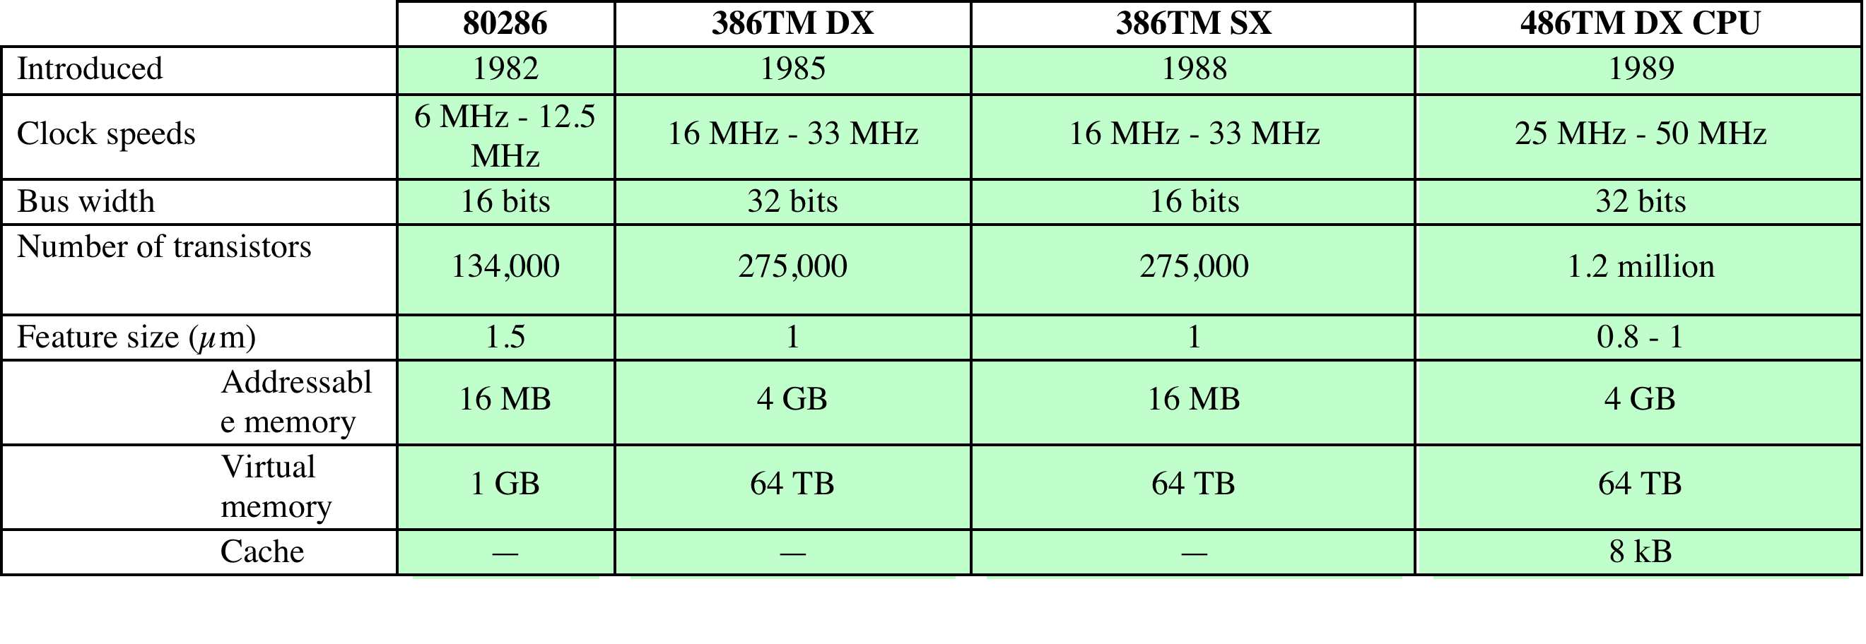
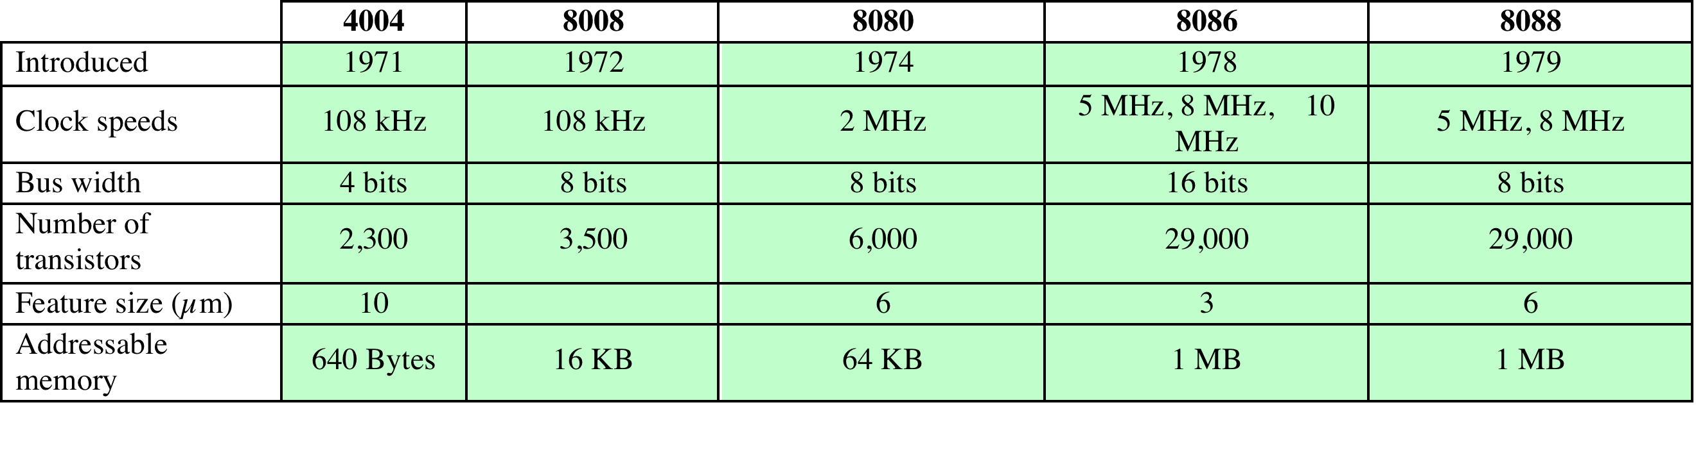
Evolution of Intel Microprocessors
a. 1970s Processors
b. 1980s Processors
Notes:
About the same time, 16-bit microprocessors began to be developed. However, it
was not until the end of the 1970s that powerful, general-purpose 16-bit microprocessors
appeared. One of these was the 8086. The next step in this trend occurred in 1981,
when both Bell Labs and Hewlett-Packard developed 32-bit, single-
chip microprocessors. Intel introduced its own 32-bit microprocessor, the 80386, in 1985 (Table 2.6).

Slide 63
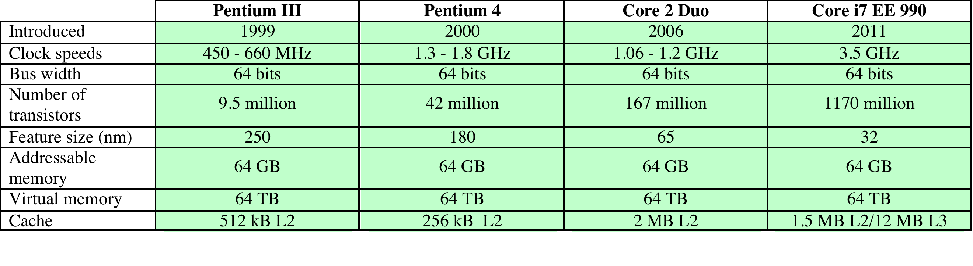
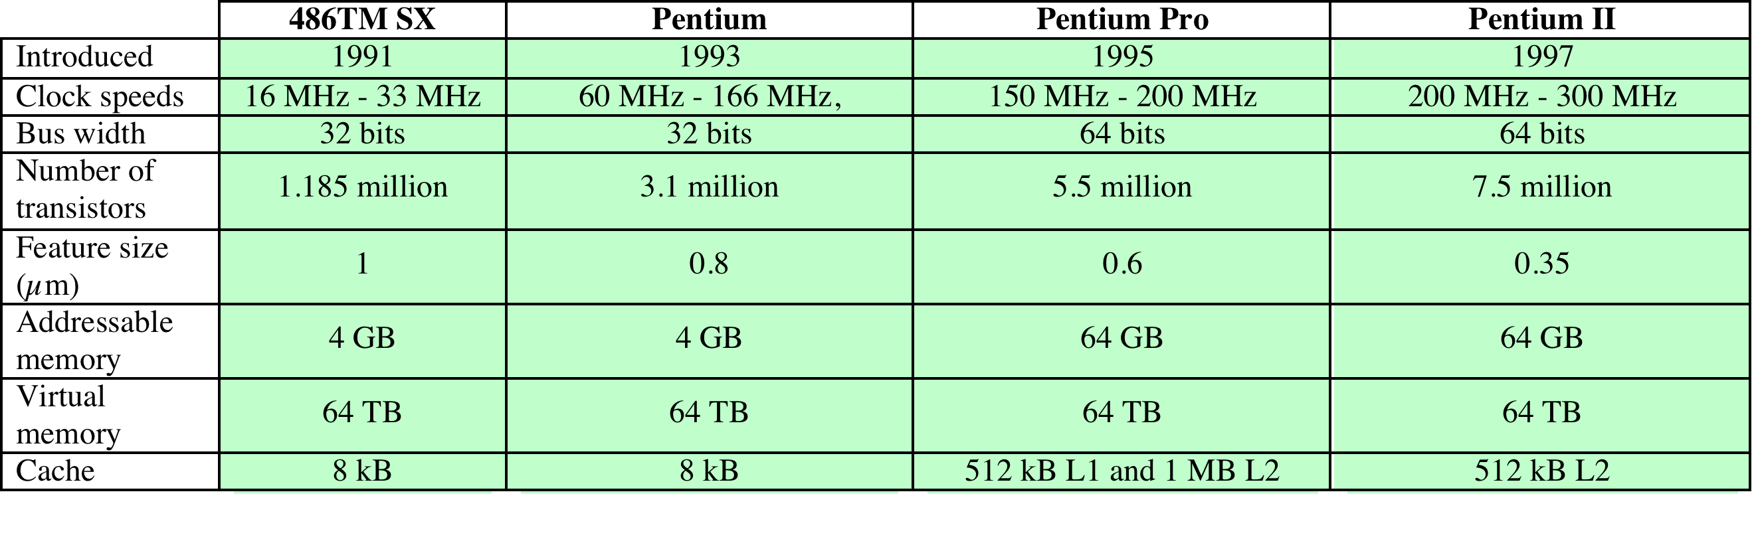
Evolution of Intel Microprocessors
c. 1990s Processors
d. Recent Processors
Notes:
Table 2.6 (continued)

Slide 64
Fifth Generation (1990s–2000s) – Parallelism & Networking
Hardware: Very Large Scale Integration (VLSI) → millions of transistors.
Multi-core processors emerge.
Networking + Internet shape architecture demands.
Examples: Intel Pentium series, AMD Athlon, early ARM processors in mobile devices.
Architecture: Superscalar, pipelining, branch prediction, caches for speed.

Slide 65

Sixth Generation (2010s–Now) – Heterogeneous & AI-focused
Hardware: Multi-core, many-core, GPUs, TPUs.
ARM becomes dominant in mobile devices (low power).
Apple shifts Macs to ARM (Apple Silicon M1, M2, M3).
Cloud computing and data centers demand specialized processors.
Architecture: RISC-V (open-source ISA) gaining popularity.
Specialized chips: AI accelerators, neural processing units (NPUs).

